Slide 1


Automated News Categorization for HuffPost
Guy Dulberg, Guy Zagorski, Noam Ben Moshe
Data Science in Industry

Slide 2
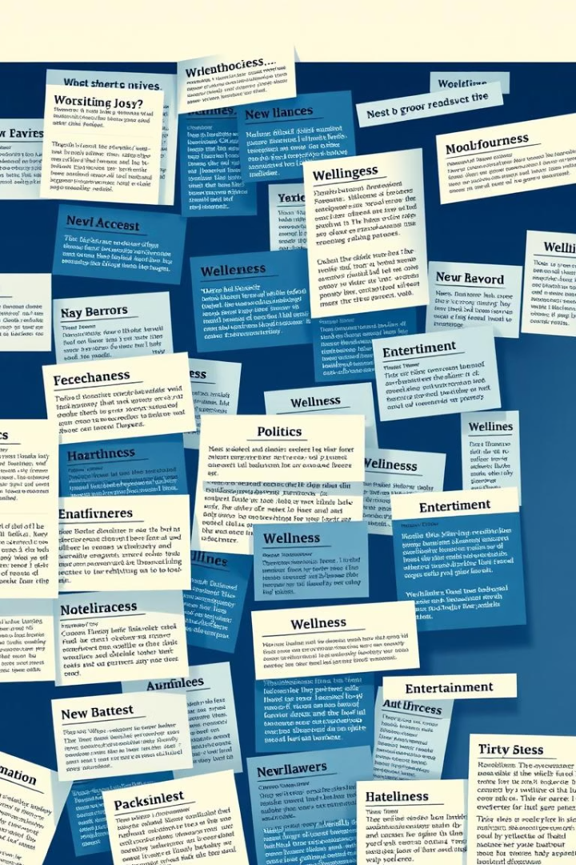




Executive Summary: Project Goals & Value
Project Goal
Classify articles into categories automatically.
Dataset
210k articles (2012-2022).
Models Proposed
LSTM, Naive Bayes, Logistic Regression, LinearSVM.
Business Value
Reduce workload, boost engagement, enable real-time publishing.

Slide 3

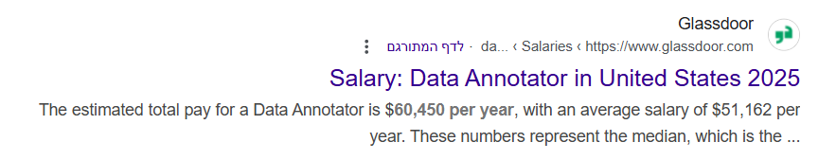
Business Problem: Manual Categorization Bottleneck
Issue
Solution
Impact
Editors spend ~2 minutes per article for manual tagging.
Automation reduces tagging time to < 1 second.
Faster publication cycle
Analyze titles and discover trends
Enhanced ad targeting

Slide 4
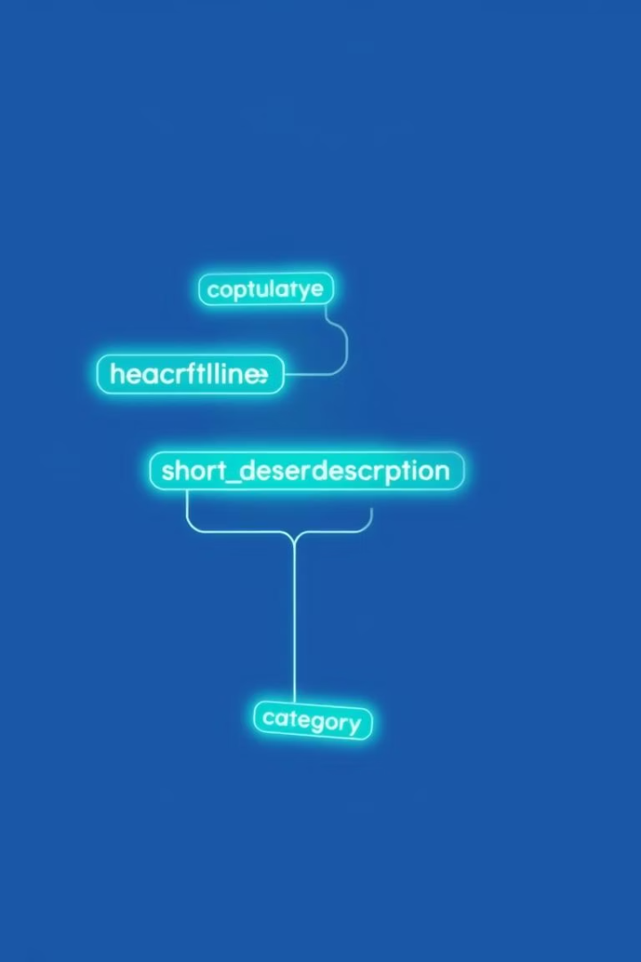
Data Overview
Format
JSON, ~210,000 records
Fields Used
Headline, Short Description, Category
Time Range
2012-2022
Top Categories
POLITICS, WELLNESS, ENTERTAINMENT
Sample from the dataset :
Headline: 23 Of The Funniest Tweets About Cats And Dogs Short Description: "Until you have a dog you don't understand what it means to do something for someone else." Category: Comedy Author: Elyse Wanshel Publication Date: September 23, 2022 Link: https://www.huffpost.com/entry/funniest-tweets...

Slide 5
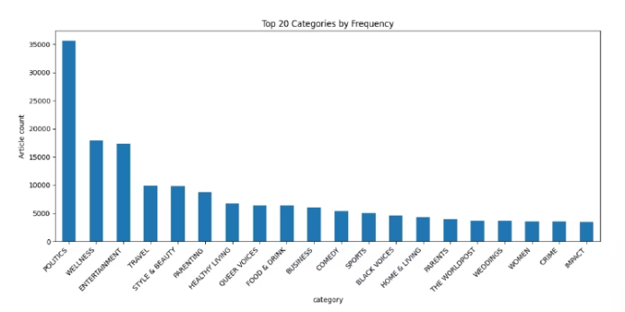
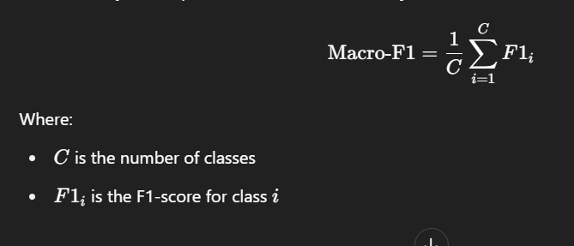
Exploratory Data Analysis Findings
Class Imbalance
Observation: The dataset is heavily imbalanced—POLITICS has ~35,000 articles, while many other categories have fewer than 1,000.
Consideration: This imbalance can bias the model toward dominant classes and reduce overall performance on less-represented ones.
Action: We'll evaluate models using macro-F1, while focusing 30 most frequent categories
POLITICS: ~35k records vs. several < 1k.
Treats all data equally , Highlight poor performance on minority class

Slide 6


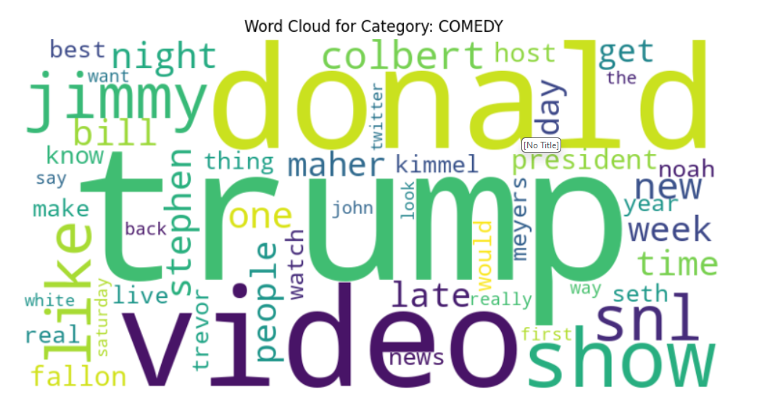
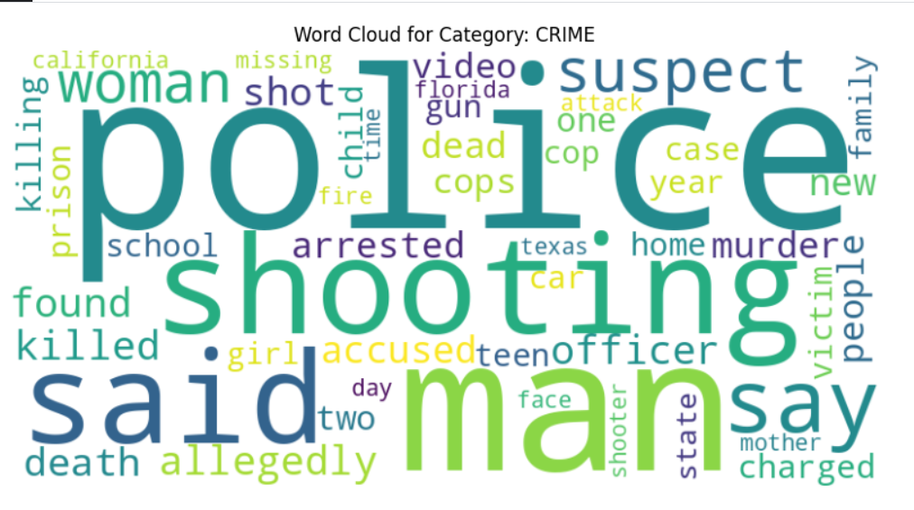
Exploratory Data Analysis Findings

Slide 7
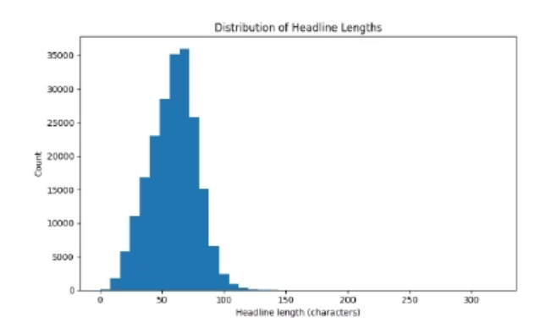
Exploratory Data Analysis Findings
Text Length
Headline: avg 58 chars; Description: avg 114 chars.
Observation: Some entries are missing text, while others contain unusually long descriptions.
Consideration: Empty texts may reduce model effectiveness; long texts could skew TF-IDF representations
Action: Remove entries with both fields empty or in case edges such as long texts (~0.01% of data).

Slide 8
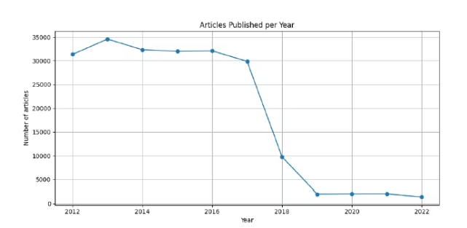
Exploratory Data Analysis Findings
Temporal Coverage
Volume rises steadily from 2012 to 2017, then drops after 2018 when HuffPost reduced its archive
.
Observation: Article volume increased steadily from 2012 to 2017, then declined sharply after 2018—likely due to HuffPost reducing its archival coverage.
Consideration: This drop may introduce temporal bias and affect the model's ability to generalize to recent content.
Action: Hold out the latest 12 months as a forward-looking test set to assess how well the model performs on contemporary data.

Slide 9
Exploratory Data Analysis Findings
Temporal Coverage
Volume rises steadily from 2012 to 2017, then drops after 2018 when HuffPost reduced its archive
.
Accuracy score overall : 67.52%
Accuracy score (test contain articles from 2020-2022 ) : 61.73%

Slide 10
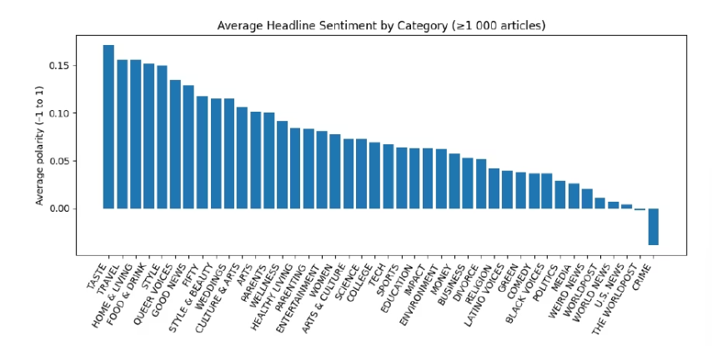
Exploratory Data Analysis Findings
Sentiment Variation
Observation: Sentiment varies widely across categories—headlines in TASTE, TRAVEL, and FOOD & DRINK tend to be strongly positive, while those in CRIME and U.S. NEWS are notably more negative.
Consideration: This emotional tone likely reflects the nature of the content and could provide useful signals for category prediction.
Action: Include sentiment polarity and subjectivity as input features to help the model better separate emotionally distinct categories, particularly in edge cases.

Slide 11
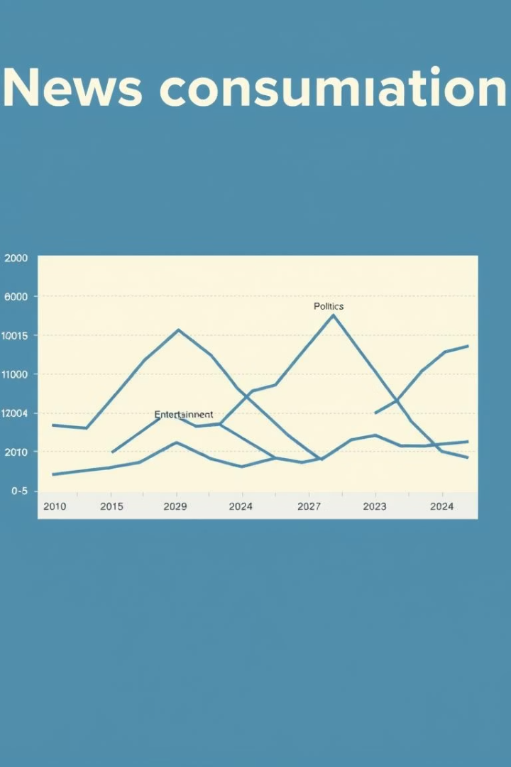




Business Insights from EDA
Category Drift
Temporal Training
Sentiment Features
Proportions shifted; lifestyle categories disappeared post-2018.
Use temporal splits to account for data drift.
Headline sentiment varies by category.
Topic Distinction
Polarity helps distinguish topics (e.g., CRIME vs. GOOD NEWS).

Slide 12
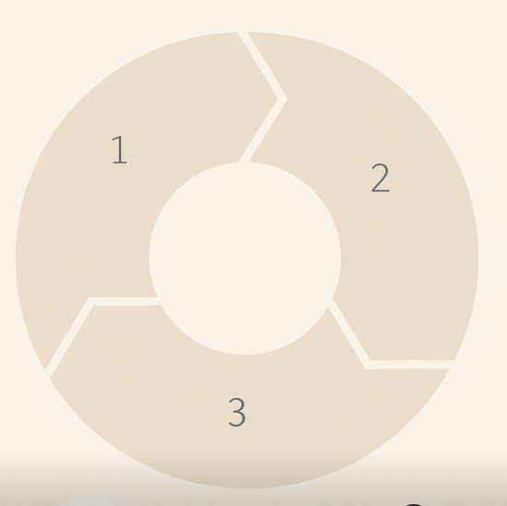

Key Business Value Goals & Impact
Time Savings
Tagging reduced from ~2 min to < 1 sec.
Scalability
Make efficient model for use for Big data that holds articles.
Cost Savings
Estimated $60K/year in operational savings.

Slide 13

Limitations & Risks
Editor Trust
Long-tail Prediction
Ensuring acceptance of automated tagging.
Temporal Generalization
Harder for less frequent categories.
Challenges across evolving news cycles with context shift.
.

Slide 14




Technical Approach
Preprocessing
Clean text
Remove duplicates
Filter 30 top categories
Remove Edge cases for text length
Model Candidates
LSTM (with embeddings)
Naive Bayes + TF-IDF
Logistic Regression + TF-IDF
LinearSVC

Slide 15
Results
Naive Base Macro F1-score: 0.3729 | Logistic Regression Macro F1-score: 0.5460
LSTM Macro F1-score: 0.45 | Linear SVC Macro F1-score: 0.58

Slide 16

Next Steps
External Validation: Test on newer articles to ensure the model handles recent content.
Feedback Loop: Monitor and update the model to adapt to changing topics, categories and language..

